Slide 1


Electrical Installation

Slide 2

Hazardous area
Explained from European Standard
Classified in to three different zones
ZONE 0
Continuous risk (e.g. ventilation pipe)
ZONE 1
Primary risk (present during normal operation)
ZONE 2
Secondary risk (not during operation or during very short time)
Note:
A dusty environmental can be classified as hazardous area

Slide 3
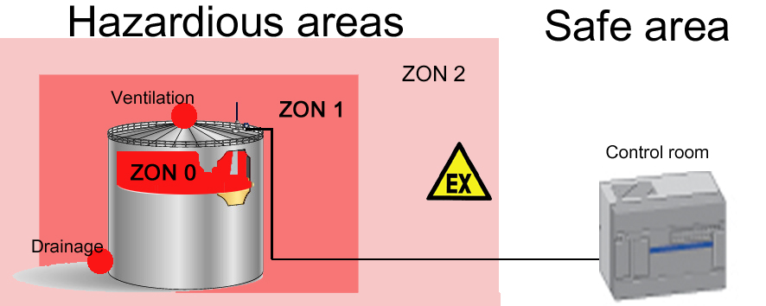
Ex zone example

Slide 4
Temperature classification
T1 – T6
The highest component surface temperature the equipments are allowed to reach.
Examples:
Ignition temp
Gasoline: 400°C
Naphtha: 230°C
Fuel oil: 200°C
----- 450°C
----- 300°C
----- 200°C
----- 135°C
----- 100°C
----- 85°C
T1
T2
T3
T4
T5
T6

Slide 5
Explosion groups
Classifying of gases and vapors
Related to:
Ignition through gap
Lowest energy for ignition
I Methane
IIA Gasoline, Propane, most fuel oils
IIB Ethylene
IIC Acetylene, Hydrogen

Slide 6
Explosion limits
Acetylene
Gasoline
Butane
Methane
Propane
1,5-100
0,6-8
1,5-8,5
5-15
2,1-9,5
0%
Only air
100%
Only gas
Volume %

Slide 7
Electrical design in Ex area
Flame proof enclosures, Exd
Ignition can appear but should be kept inside the enclosure
Limitation of power consumption/supply, Exi
not enough with power to generate a spark
not enough power to create heating of equipment
Increased safety, Exe
Simple equipment
Junction boxes
No risk for sparkles during normal operation
Exd enclosure

Slide 8
Intrinsic safe equipment
Barrier data needs to match field equipment
Power supply
Maximum Voltage and Current
Capacitance/Inductance
Cable needs to be calculated
Ignition not allowed
Barrier
Non IS
IS
IS
apparatus
Safe area Hazardous area
Notes:
A barrier is needed if a cable

Slide 9
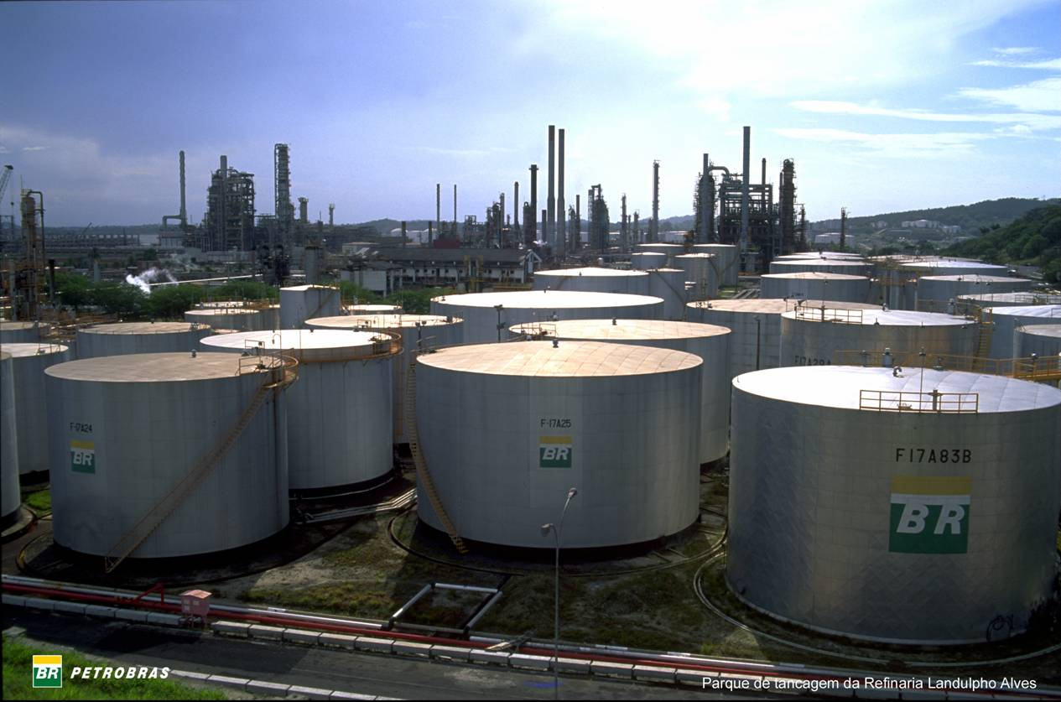
Electrical design
How to connect gauges to control room
Cabling
Grounding
Shielding
Field bus
Requirements
Layout
Number of tanks

Slide 10
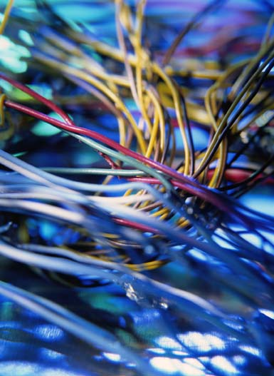
Cables
Communication performance affect by:
Cable length
All cable segments to be counted
Cable area
Losses appears in thin cables
Shielding
Disturbance shield
Grounding
Electrical safety protection
Cable environment
High tension leads
Radio transmitters

Slide 11

Cables
Maximum cable length on common busses
RS232 15 m
RS485 1200 m
Profibus 1200 m
FF 1900 m
TRL/2 4000 m
Optical fiber – up to 60000 m and above (depending on modems)

Slide 12
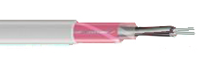
TRL/2 bus
Cable requirement (FBM – FCU – RTG/IDAU)
Individual twisted and shielded pair.
Minimum AWG20 / 0,5 mm².
0,75 mm² or more to run the maximum 4000 m of cable length
Loop resistance <200 Ω.
Typical ~10 Ω
FKAR-PG
Notes:
This is what we recommend for type of cable if a TRL/2 bus is to be installed

Slide 13
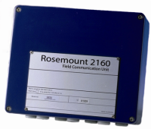
Simple TG system
Group Bus
HOST – FCU/Tank Hub
Field Busses
FCU – Tank Hub or other field device

Slide 14

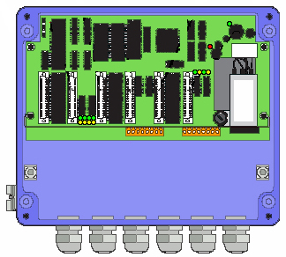
PC to FCU
Direct communication between PC and FCU
PC RS232 Com-port and FCU terminals
Only ”point to point”
Maximum cable lenght
15 meters
RS 232 in FCU
Jumper needed at X5 (X6)
RS 232 in FCU
Cable connection at X10 (X11)

Slide 15
PC to FCU
Communication via FBM and TRL/2 bus
RS232 or USB from PC to FBM
FCM board as connection in FCU (to FBM)
”Multidrop” on group bus is possible (Multiple FCU or FCU redundancy)
Maximum 3 FCU’s for 1 FBM
Relates to:
Electrical load on bus
Addressing rule
Uppdate rate (Scan time)
FCM in FCU
Placed at X5 (X6)
Optional X3 + X4

Slide 16

FCU to Tank hub, Rex and Pro
TRL/2 Bus
Max 4000 meter cable
Shielded and twisted cable
Recomended max 8 devices connected per segment
(4 if direct to FBM)
Non IS
Alternative
connection
Field devices are recomended to be connected in a ”star”

Slide 17
Rex and Pro to display and temp
Rex to SDAU/RDU
Pro with DU2210
RS485
4 wire cable
required
Power
Ground
Signal A
Signal B
Internal bus
3 wire cable
required
Power
Ground
Signal
Maximum cable length
depending on cable specifications. (IS rules)
Typical around 100 meters.
Maximum 50 meter cable
between REX and SDAU/RDU

Slide 18
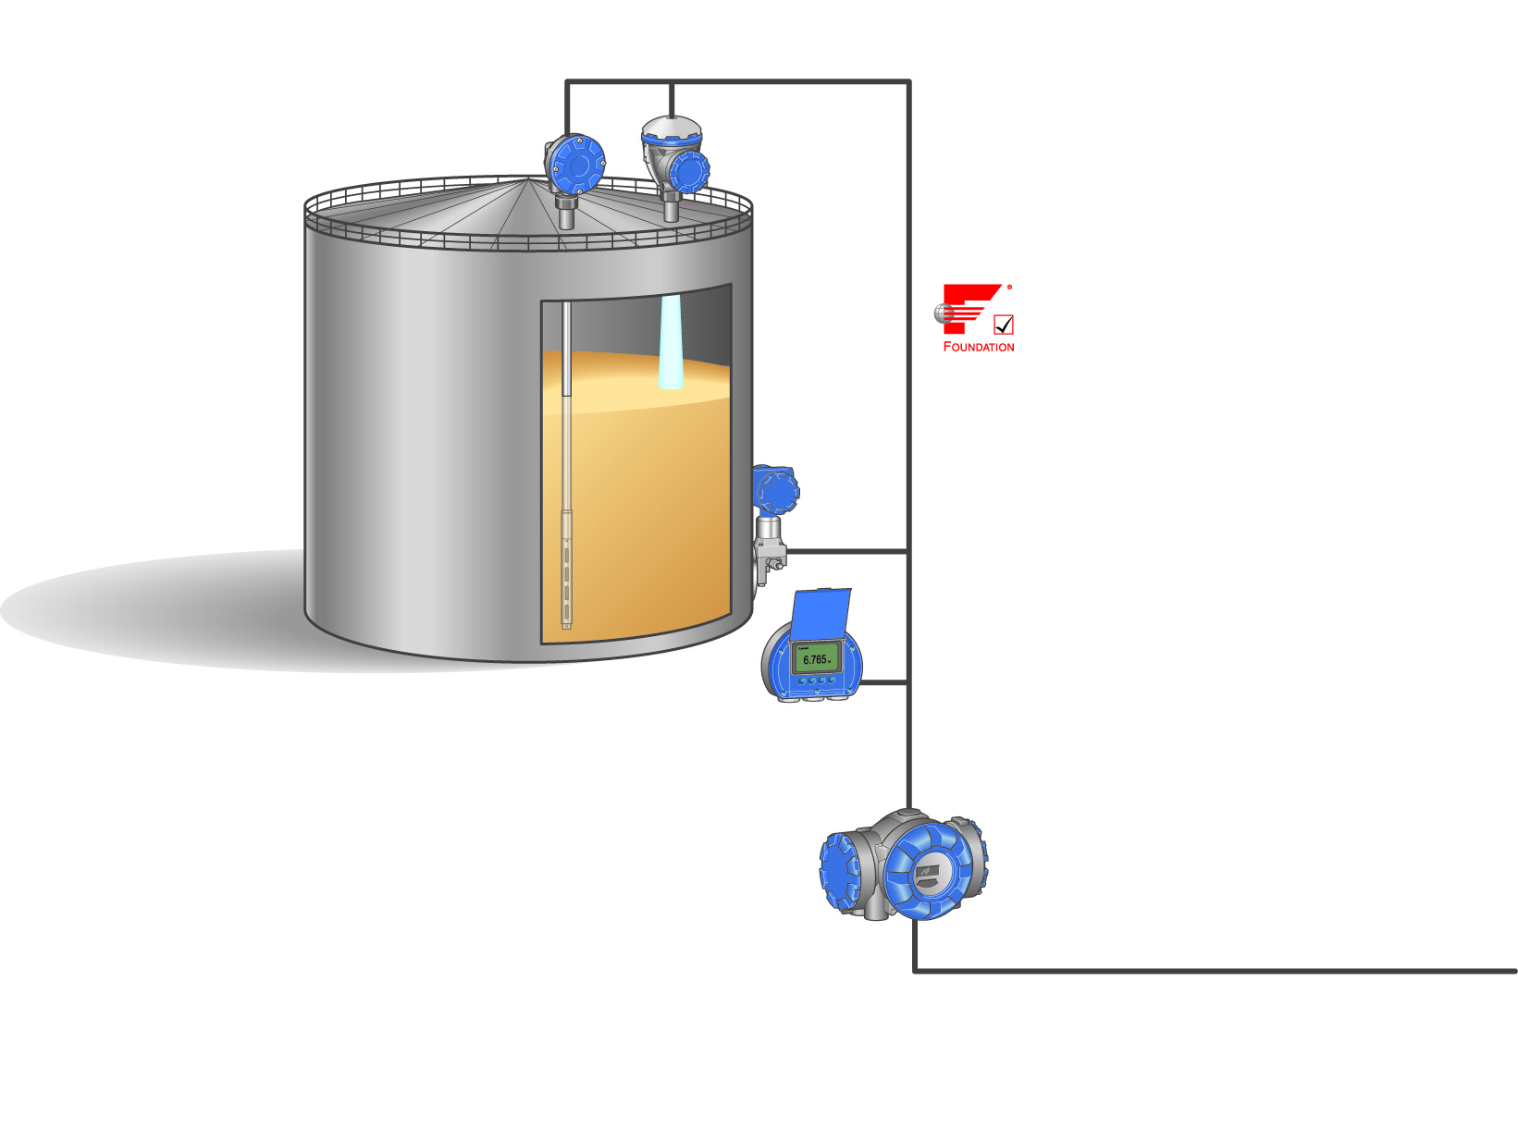
Raptor Tank bus
Recommended cabling:
Shielded twisted pair, 0.75 mm² (AWG 18)
Twisted pair 0.5-1.5 mm² (AWG 22-16) also possible
Must fulfill FISCO cable and installation requirements (see table below)
Parameter | Value
Loop resistance | 15Ω/km to 150Ω/km
Loop inductance | 0.4 mH/km to 1 mH/km
Capacitance | 45 nF/km to 200 nF/km
Maximum length of each spur cable | 60 m in gas Group IIC
Maximum length of each trunk cable | 1000 m i gas Group IIC, and 1900m in gas Group IIB
Tankbus
Fieldbus

Slide 19
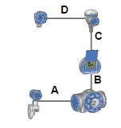
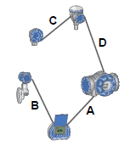
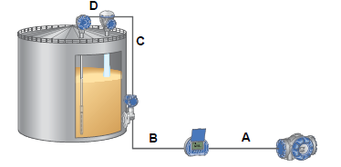
Re-use of existing cables
Possible to re-use the existing cabling if compliant to FISCO requirements
0.75 mm² (AWG 18)
42 Ω/km (loop resistance)
115 nF/km
0.65 mH/km
Tankbus length up to 1000m depending on number of devices and cable quality
The total cable distance A+B+C+D must not exceed the values given in the examplex/table below.
Cable diameter | Loop Resistance | Maximum cabling distance from power source to all devices on tank
 |  | With max power usage of 250 mA. | With typical usage of 128 mA for 5900S, 2240S, 2230, 3051S. | With typical power usage of 178 mA for 5900S 2-in-1, 2240S, 2230, 3051S.
20 AWG (0.5 mm²) | 66 Ω/km | 212 (695) | 414 (1358) | 298 (978)
18 AWG (0.75 mm²) | 42 Ω/km | 333 (1092) | 651 (2136) | 468 (1535)
17 AWG (1.0 mm²) | 33 Ω/km | 424 (1391) | 829 ( 2720) | 596 (1955)
16 AWG (1.5 mm²) | 26 Ω/km | 538 (1765) | 1000 (3281) | 756 (2480)
Distance in m (ft)

Slide 20

Field Cabling Rex & Pro
Keep power and signal cables separated to avoid noise from power supply system to disturb communication.
If possible use different cable trays or conduits
Warning:
Pay special attention for occurrence of disturbance if and when
the site has VFD (Variable Frequency Drives)
Notes:
Avoid

Slide 21
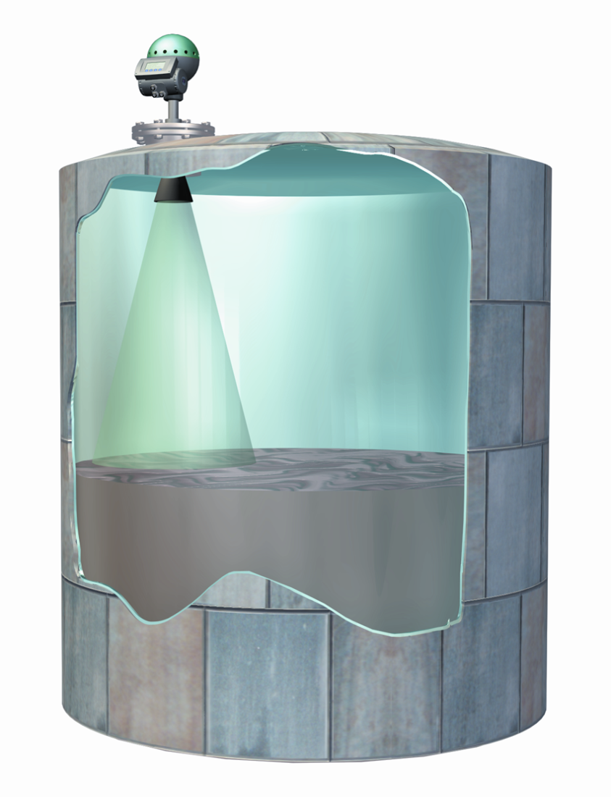
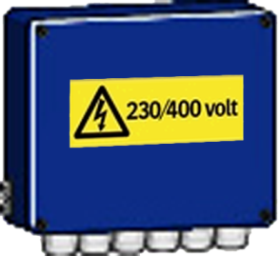
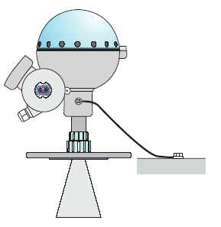

Grounding of screen Rex & Pro
Gauge grounded
to tank
Power supply
All equipment connected to a high tension power supply (> 60V) should be connected to
central grounding system, PE.
Cables grounded
in both ends.
Min 4 mm²
FCU

Slide 22

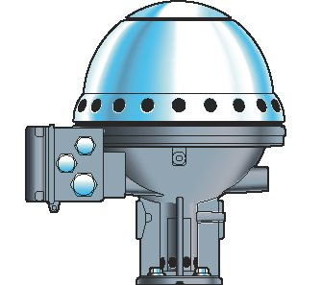
Grounding of shield Rex & Pro
Communication cables
Cable shield should be of folio type
Protective shield should only be grounded
(connected to earth) at the master side.
In FCU for FCU – RTG
At FBM for FBM – FCU
Local laws and regulation in how to apply
grounding and shielding should be followed
and might differ between countries
Isolated
shield

Slide 23
Continuous shield Rex & Pro
Field Junction Box
Shields in JBs and
field equipment
should NOT
be grounded,
connected to earth
To other RTGs
Isolated
shield

Slide 24
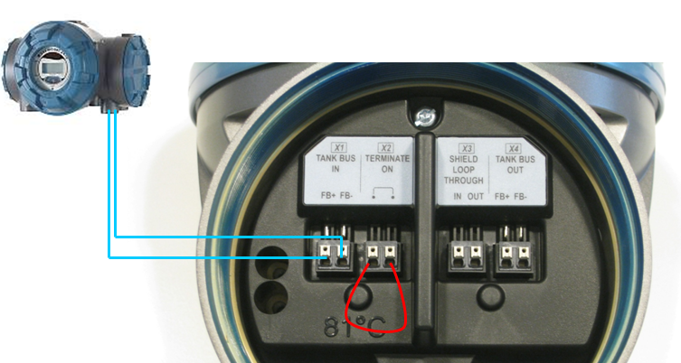
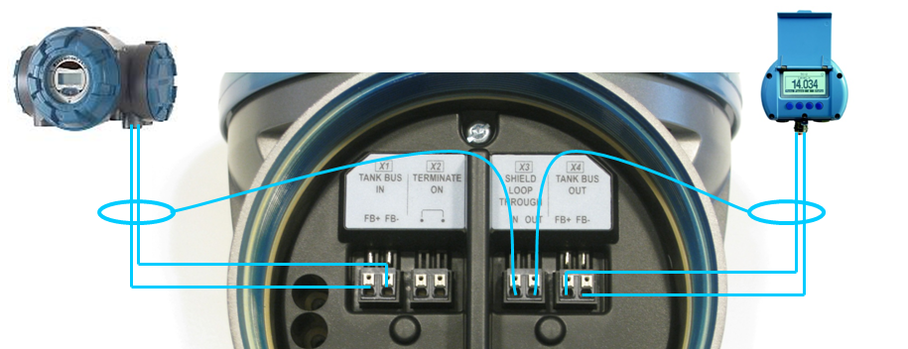
Grounding of shield Raptor
Shield wire usually require a single grounding point
Shall be located at the power supply (Tank hub)
Cable shield inside terminal must be isolated or looped through
To avoid unintentional grounding points
Isolated
shield
Looped through

Slide 25
Field cabling
If using a multi-cord cable
Each pair should be twisted
Each pair should be individual shielded
Individual Shield
Common Shield
Wherever two or more TRL/2 Bus segments run alongside each other, sharing the same cable or conduit tube, the use of twisted and shielded wires is needed to make sure that crosstalk and overhearing is avoided.

Slide 26
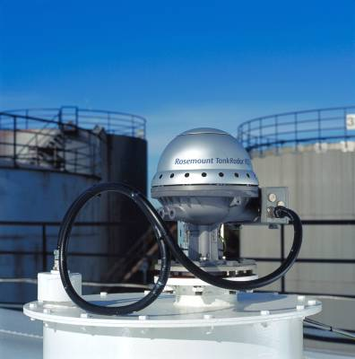
Cable installation
Make sure that cables are protected from possible mechanical damage.
Cable trays
Conduits
Flexible hoses
For service action
Cable loop at head will make it possible to move the TH without disconnect the cables

Slide 27
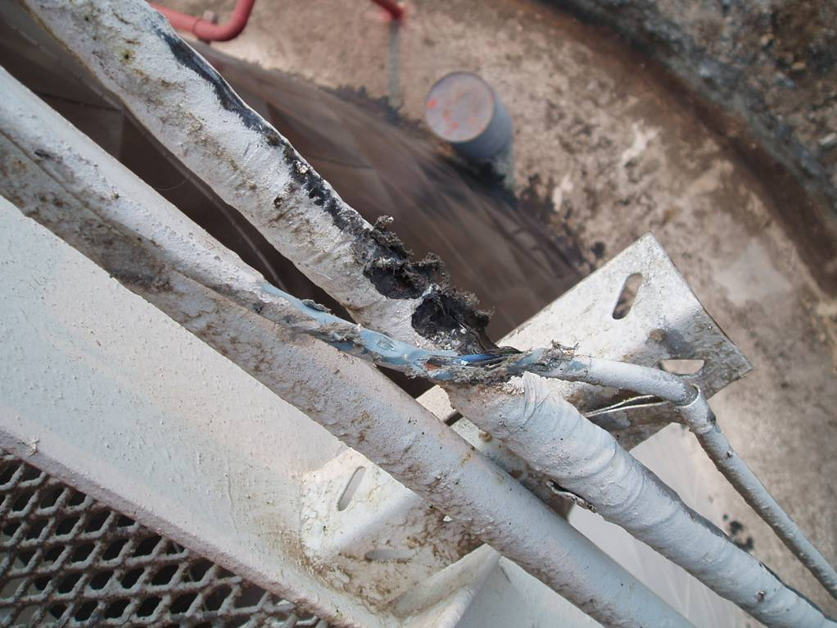
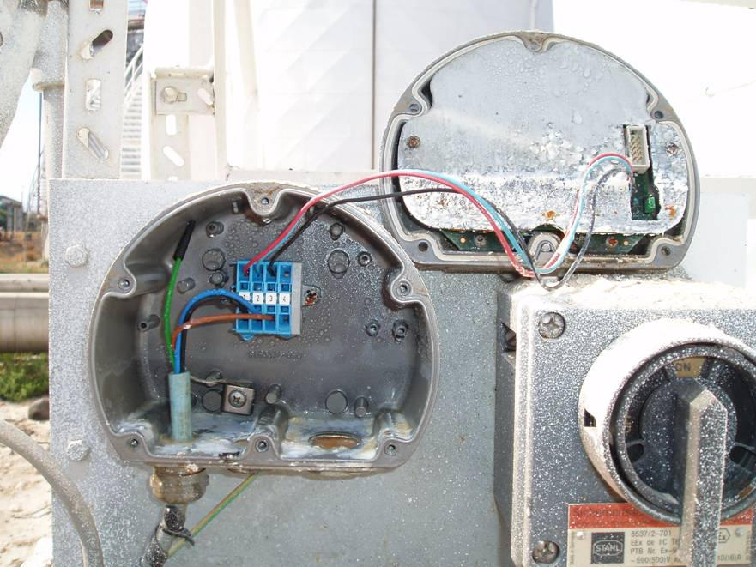
Bad Examples
Wounded cables due to mechanical damage.
Made water enter into the RDU placed at the bottom of the tank.

Slide 28
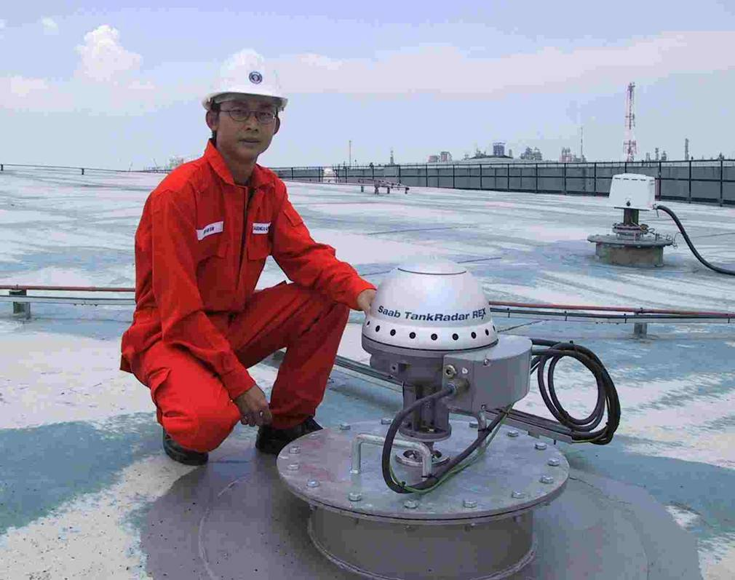
Cable installation
The Flexible Hose should have a lower point before the REX head to prevent water to penetrate the housing.
REX is classified IP 67
IP 67 = Submerged in Water at 1 meter for ½ hour. No visible leakage

Slide 29
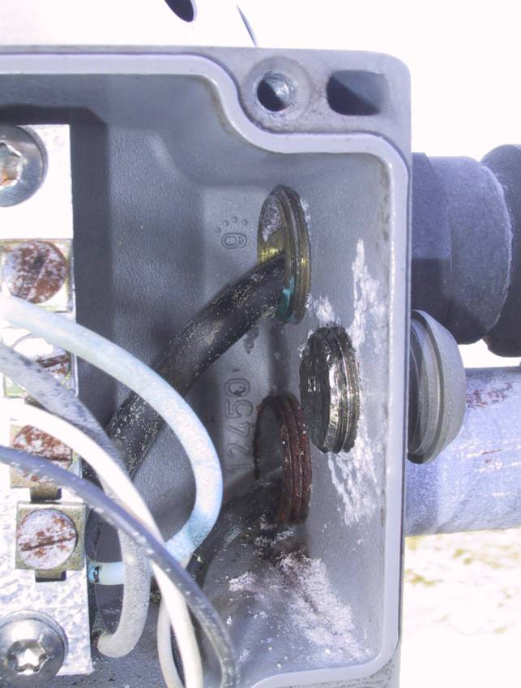
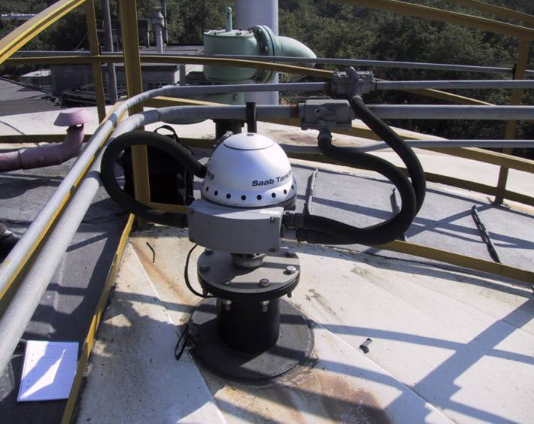
Bad Examples
Water entering REX JB caused by wrong mounting of conduits
Lowest point at REX

Slide 30
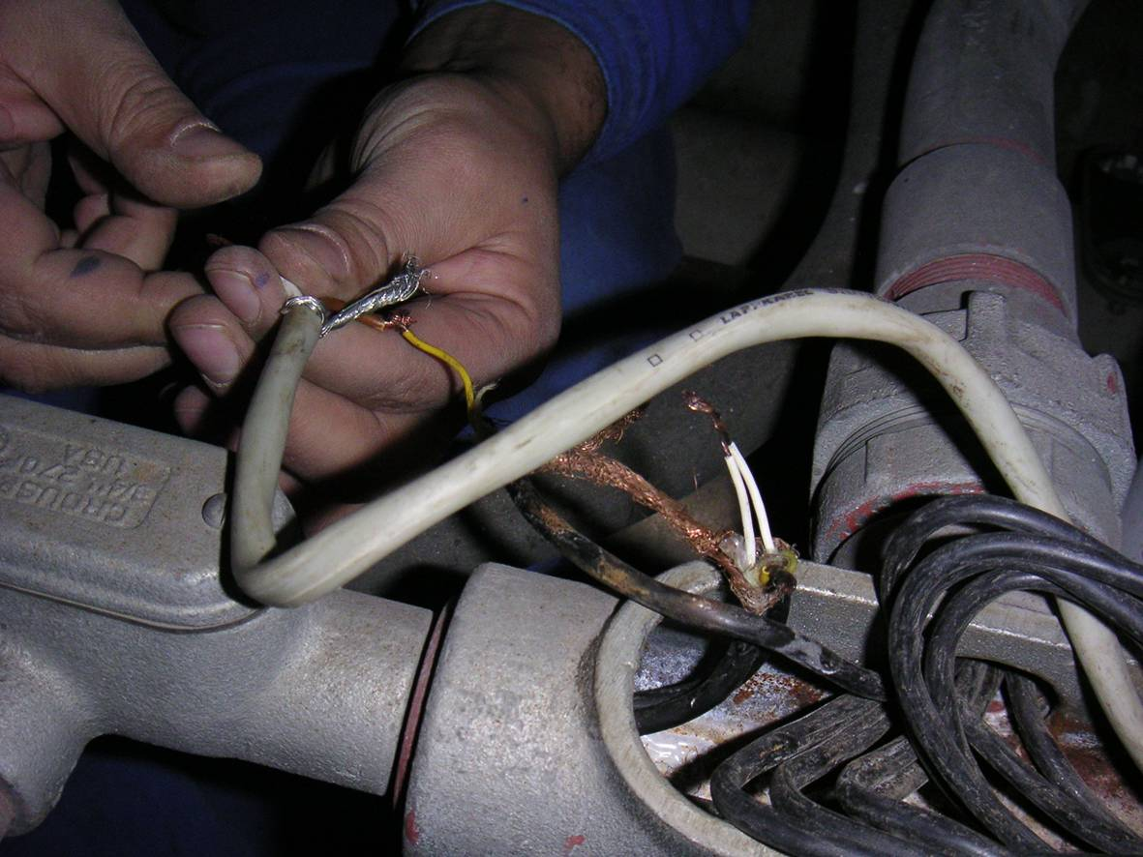
Bad Examples
Problems with a lot of c-fails to field equipment
Disturbances in the communication
Wires not properly connected
Shield not insulated,
= connection to ground
Cable not twisted
Avoid “basic” mistakes
and gain a better system
performance

Slide 31
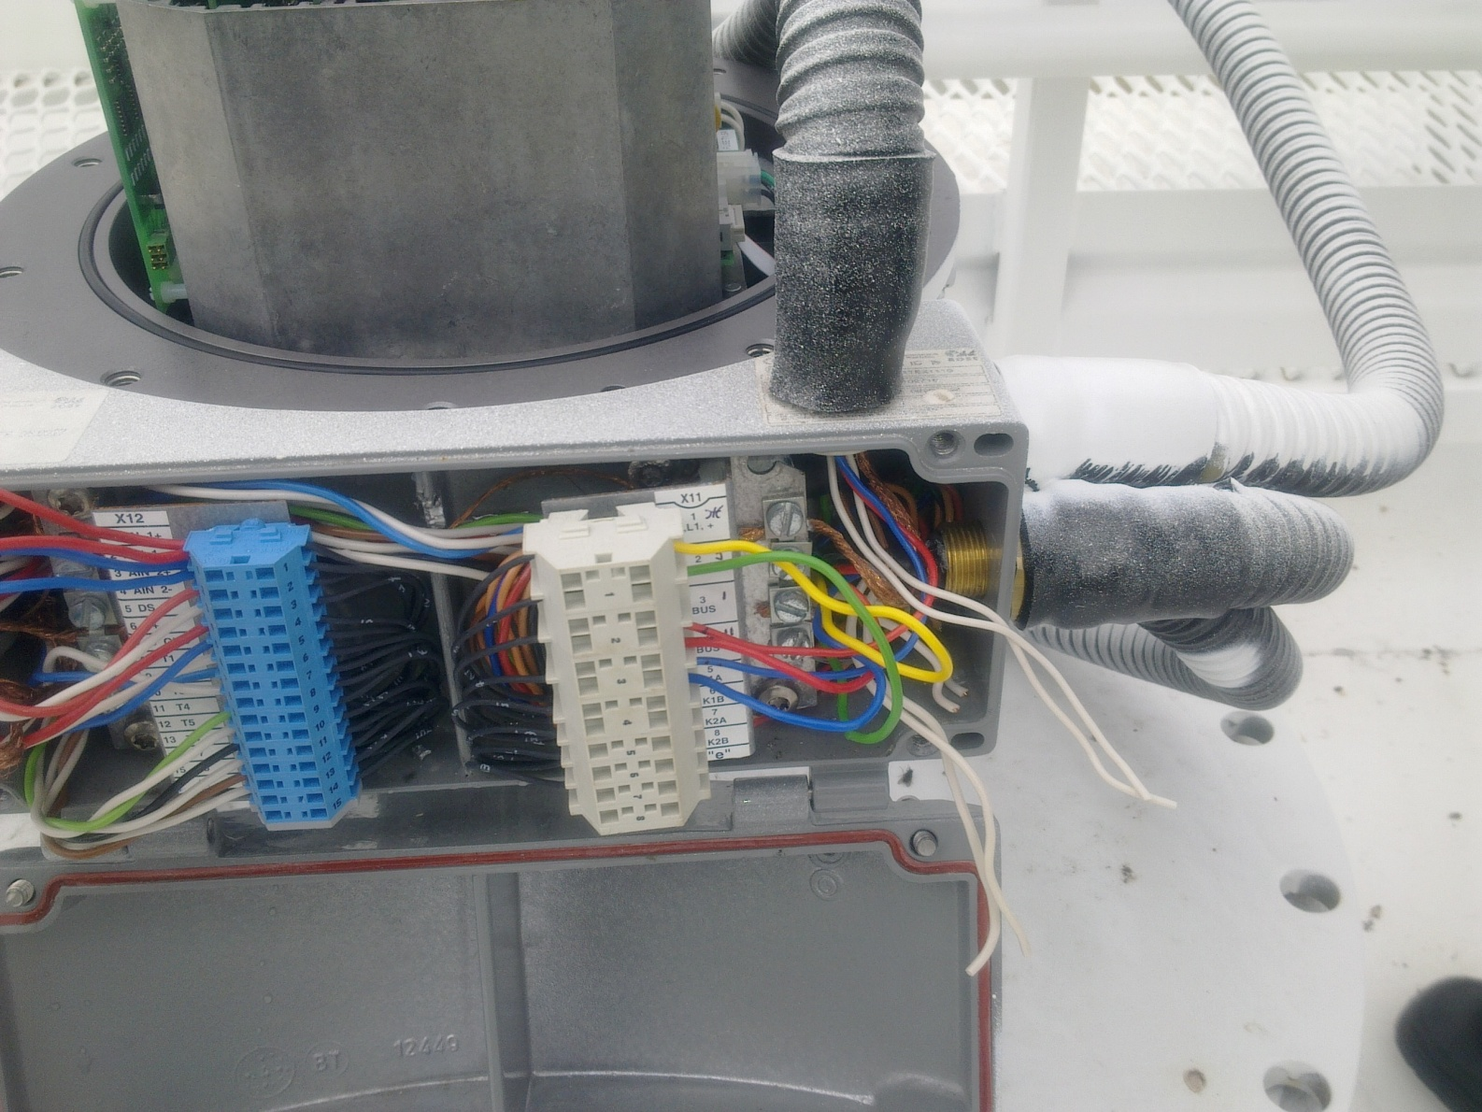
Bad examples – what’s wrong?
’Special’ cable entrance
(not allowed to modify Certified JB)
Cables from NON-IS side going to IS-side
(Certificate not valid anymore)

Slide 32

Additonal Sensors
Connection of
MES
WLS
PT

Slide 33
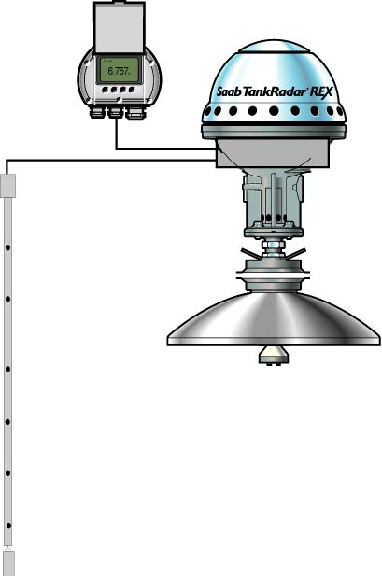
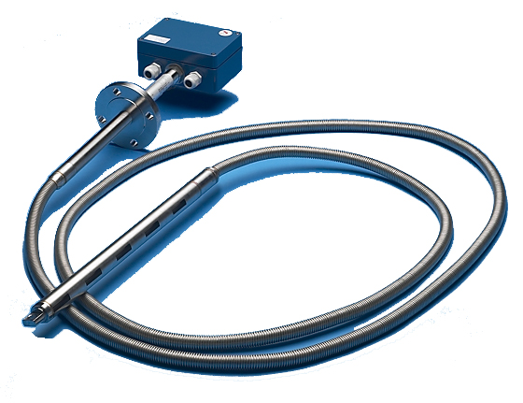
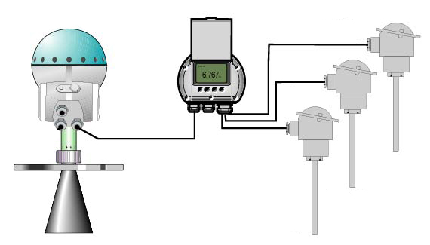
Temperature sensors
Connects to:
REX (max 6 elements)
SDAU for REX (max 14 elements)
2210 DU for PRO (max 6 elements)

Slide 34
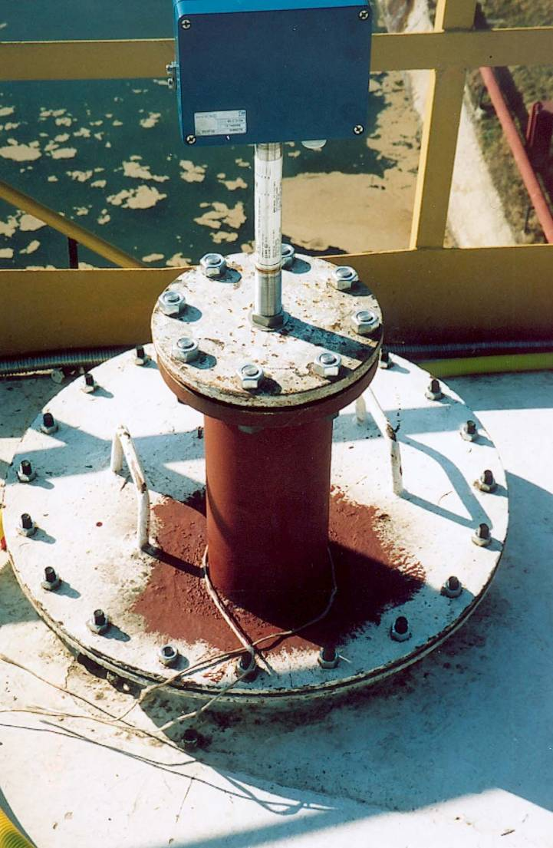
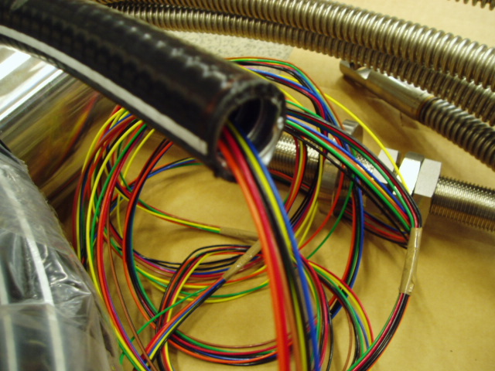
MST
Max 10 meter wires from sensor, use JB if longer distances to connection point

Slide 35
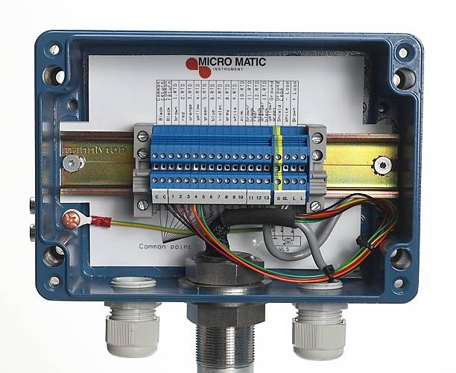
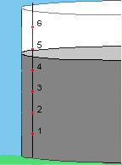
MST
Up to 14 spots
Spot 1 at the bottom
Integrated WLS
Color coding
Return wires – Black
Spot 1 – Brown
Spot 2 – Red
Spot 3 – Orange
Spot 4 – Yellow
Spot 5 – Green
Spot 6 – Blue
More colors in drawing 9240 003-912

Slide 36
WLS
Water Level Sensor
Connects with analog 4-20 mA signal
REX
I/O Terminal
Old equipment
RTG TRL/2
Independent DAU
Notes:
Can be connected together with a MST if both are

